Slide 1
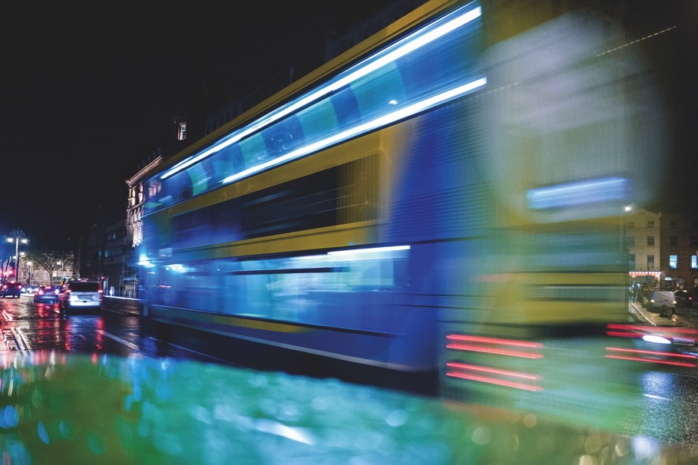
World Meeting of Families
Transport Plan
26th July 2018

Slide 2
Events Summary

Slide 3
Summary of 5 Key Events
1) RDS – 20th to 24th August
Up to 37,000 people expected daily at events
Event is sold out, 114 different countries will be represented
Staggered entry and exit times
Daily mass will be at 4pm
2) Dublin City Centre – Pope Movements, Saturday 25th August 2018
Part 1: Apostolic Nunciature, Navan Road to Pro –Cathedral
Part 2: Pro-Cathedral to Capuchin centre for the Homeless
Similar to St Patricks Festival with opportunities for people to see the Pope
Some restrictions for bus & coach movements in the city centre
3) Croke Park – Saturday 25th evening August 2018
Ticketed event 80,500 people in attendance
Pope to attend this event

Slide 4
Events Summary continued
4) Knock Shrine, Co. Mayo - Sunday morning 26th August
Ticketed event - 45,000 patrons registered for tickets
Capacity in church is 3,500
Additional people will line the route
5) Phoenix Park – Sunday afternoon 26th August 2018
Ticketed event - 500,000 patrons registered for tickets
Dublin City Centre is open for business on the day
A traffic cordon will be in place restricting vehicle movement inside the M50
Public Transport scheduled services will run as normal nationally
Some restrictions in Dublin due to road closures

Slide 5
Phoenix Park Venue and Gates

Slide 6
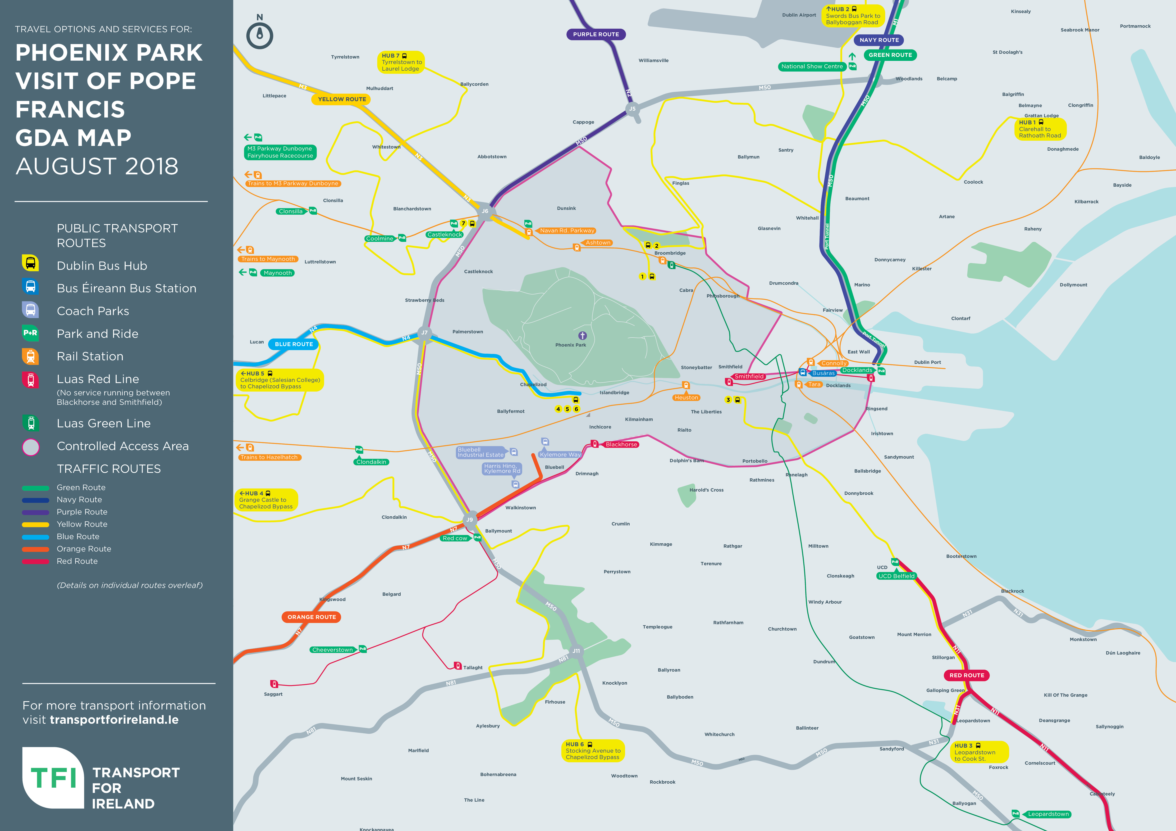
TFI Map

Slide 7
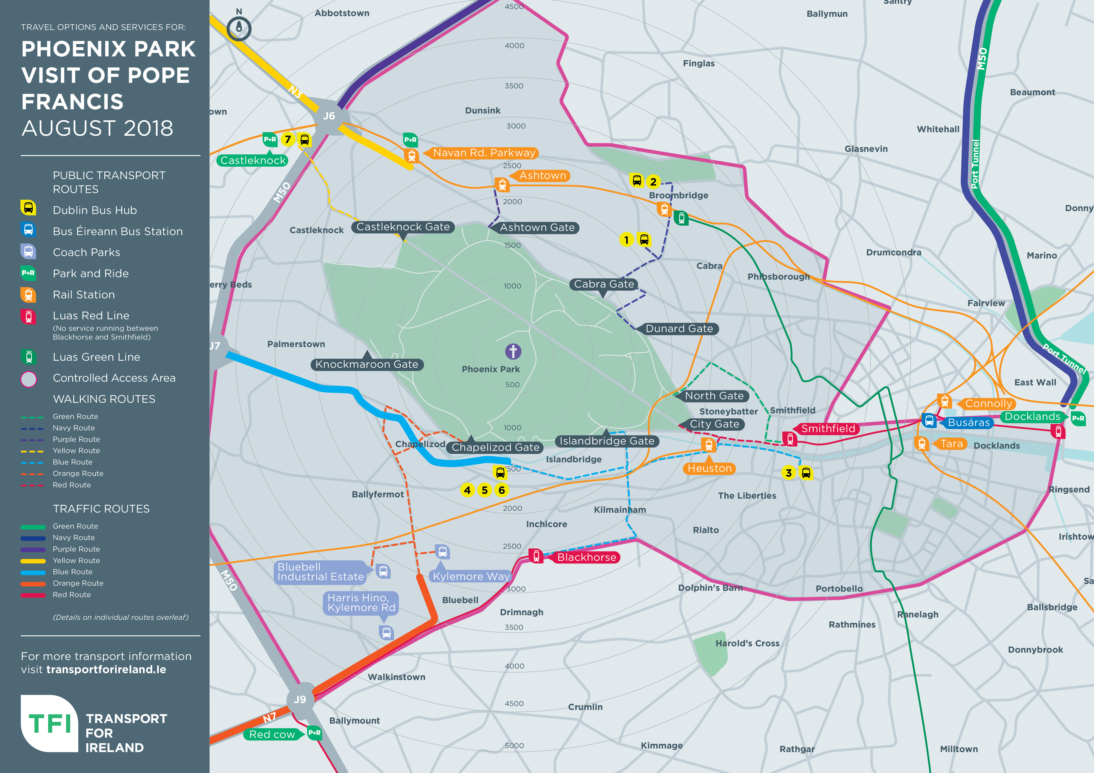
TFI Map

Slide 8
Key Transport Messages
Use public transport, or group coaches if at all possible
Pre-book your journey to Knock or Dublin
Shuttle services and Dublin city public transport is free for those attending Knock and Phoenix Park
Entry tickets to be shown to drivers & staff
Given the scale of the event:
Walking from hubs to/from the Papal Cross is necessary
Some queuing is likely
Plan to return using the same route you came on

Slide 9
Iarnród Éireann Operation

Slide 10
Iarnród Éireann Operations
Iarnród Éireann have mobilised every available train and staff member
Anyone who wishes to travel on IR services must pre-book their rail ticket. If you are a free travel pass holder, you must reserve your seat in advance of the event
In Dublin trains will run a shuttle from Connolly to Ashtown station bringing people to within a 10 minute walk of Phoenix Park gates
Trains will run from M3 Parkway & Maynooth lines to Navan Road (Parkway) which is also close to Phoenix Park
DART and commuter lines will all operate into all city centre stations
For those travelling to/from the Papal Mass the entry ticket must be shown to inspectors on request for DART and Short Hop Zone journeys
IR will carry over 50,000 passengers/hour pre and post event with the largest numbers on DART and Commuter services
There will be 10 special Intercity services before and after the event and post Event IR will carry over 150,000 passengers from 5pm until last service

Slide 11
Dublin Bus Operation

Slide 12
Dublin Bus Transport Hubs
Dublin Bus are mobilising every available bus and driver to provide additional services and special shuttle services – approx. 1,000 vehicles
7 dedicated bus services will operate to hubs bringing people reasonably close to the Phoenix Park
Walking distances to Phoenix Park gates from drop-off hubs to the assigned gate of the park will range from 1 km to 2.5 km
Dublin Bus has capacity for up to 400,000 journeys on Sunday 26th August, scheduled and special services
Scheduled services in the city area will be re-routed due to traffic restrictions – full information will be provided
For those travelling to/from the Papal Mass the entry ticket must be shown to drivers & inspectors

Slide 13
Dublin Bus Papal Transport Hubs
Hub 1: Clarehall to Ratoath Road
Hub 2: Swords Business Park to Ballyboggan Road
Hub 3: UCD Belfield to Cook Street
Hub 4: Grange Castle to Chapelizod Bypass (N4)
Hub 5: Celbridge to Chapelizod Bypass (N4)
Hub 6: Stocking Avenue Tallaght to Chapelizod Bypass (N4)
Hub 7: Tyrrelstown to Laurel Lodge

Slide 14
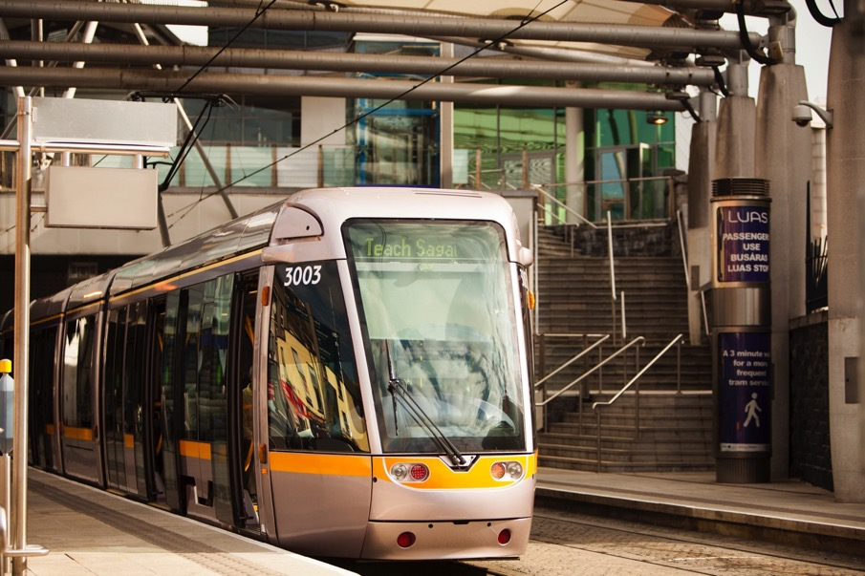
Luas Operation

Slide 15
Luas Papal Transport Plan
Luas will operate services from 7am until 11pm at a 6 -10 minute frequency on the Red line and 8-10 minute on the Green line.
For crowd safety reasons Luas Red Line services will operate to Blackhorse and from Smithfield to the Point therefore there will be NO LUAS OPERATIONS between Blackhorse and Smithfield
Luas will provide capacity for 73,700 passenger journeys on Sunday 26th of August
All available trams and staff will be working on the day of the event
Mass entry tickets must be shown to Customer Service staff on request
The Luas Red line service from the Point to Smithfield will cater for the coach park located in the Docklands area
For the first time, Luas is using the Luas Stop at the Leopardstown Racecourse and will operate a Park and Ride at the facility

Slide 16
Bus Éireann Operation

Slide 17
Bus Éireann Papal Transport Plan
Bus Éireann will operate an enhanced service on Sunday 26th August which will provide over 30,000 passenger journeys to and from Dublin on the day.
The BE operation in Dublin will be departing from Busaras, Beresford Place, Customs House Quay, Georges Quay, Talbot Street and Amiens street largely as normal.
Those intending to use Bus Éireann services to travel to Dublin or Knock MUST pre-book their seat – this includes Free Travel Pass holders.
Bus Éireann is also operating a number of special intercity Expressway services to and from Dublin on the day. Tickets for these services must be purchased in advance.
Bus Eireann is providing a Shuttle Service from Claremorris train station to Knock Shrine (free to event ticket holders)
Some diversions in Dublin will apply – full information will be provided

Slide 18
Other operators

Slide 19
Other Operators assisting in the Papal Transport plan
Go Ahead Ireland
Go-Ahead Ireland will be running shuttle services on the day of the event:
10 single deck Go Ahead buses
40 single deck Transport For Ireland buses
Go Ahead will transport approx. 6,000 people on the day
Translink N Ireland
Translink will provide up to 100 double deck buses to provide shuttle services, including Fairyhouse P&R to M3 Parkway
Translink are providing dedicated train and bus services from N Ireland to Phoenix Park on 26th August – these MUST be pre-booked
Translink have significant experience gained during the London Olympics
Local Link
Some Local Link offices are providing transport to events using their fleet of accessible vehicles
Pre-booking is essential for those planning to use Local Link services

Slide 20
Transport Hubs

Slide 21
Transport Park & Ride Hubs
UCD Belfield
Park your car and take a bus to the Phoenix Park
2417 car parking spaces available
Dublin Bus providing the shuttle service to the event
2) Maynooth University/M3 Parkway
Park your car and take a train into the Phoenix Park
Over 1,500 car parking spaces at this site
3) Leopardstown Racecourse
Park your car and take the Luas
4000 car parking spaces
A new temporary walkway from the Luas platform to the racecourse car park
This may become a joint bus/Luas operation if required
4) Fairyhouse Racecourse
Park your car and take a bus to the M3 Parkway train station
6,308 car parking spaces available
Translink providing the shuttle service to train station

Slide 22
Questions?
(Further details available in
subsequent slides)

Slide 23
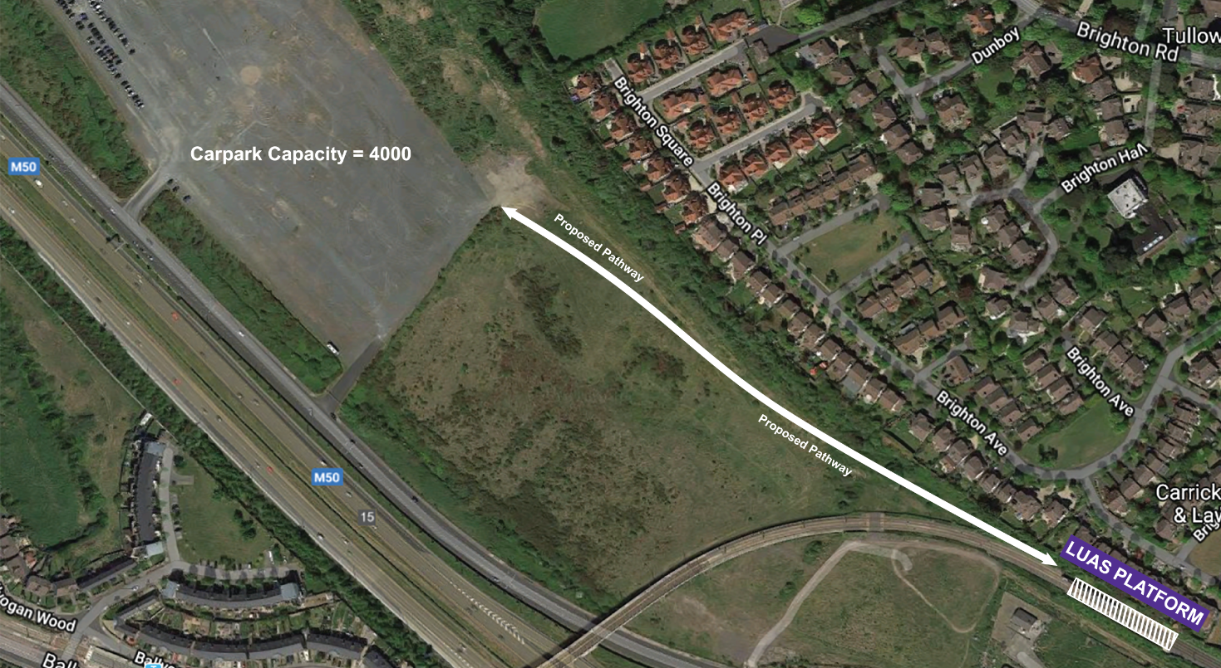
Leopardstown Transport Hub

Slide 24
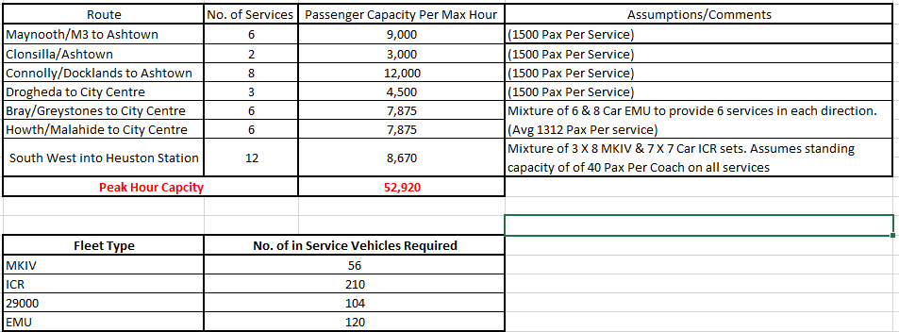
Rail Papal Operation

Slide 25
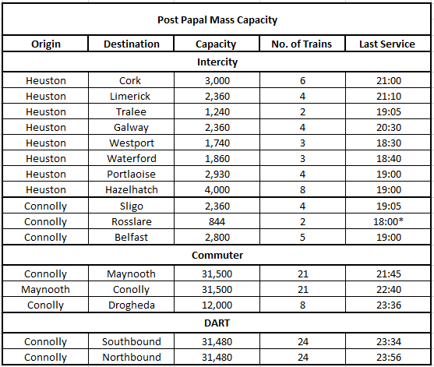
Rail Papal Operation – Post Event
Tt

Slide 26
Dublin Bus Papal Transport Hubs
Hub 1: Clarehall to Rathoath Road x 70 Buses
STOPS:
Clarehall
Leisureplex Coolock
Northside shopping centre
Santry avenue
St Margaret’s Road- IKEA
Charlestown Shopping Centre
Clearwater Shopping Centre
Hub 2: Swords Business Park to Ballyboggan Road x 30 Buses
STOPS:
Pavillions Shopping centre
National Show centre
Omni Shopping centre
DCU Collins Avenue
Glasnevin Avenue
Finglas Village

Slide 27
Dublin Bus Papal Transport Hubs
Hub 3: Leopardstown and UCD Belfield to Cook Street x 70 Buses
Hub 4: Grange Castle to Chapelizod Bypass(N4) x 30 buses
STOPS:
Grange Castle
Nangor Road
Mill Shopping Centre
Monastery Road Round Towers GAA
Naas Road- Harris Hino
Kylemore Road
Hub 5: Celbridge to Chapelizod Bypass(N4) x 30 buses
STOPS:
Salesian College
Supervalu Lucan
Griggeen Park
Pennyhill
Woodies Lucan
Liffey Valley

Slide 28
Dublin Bus Papal Transport Hubs
Hub 6: Stocking Avenue Tallaght to Chapelizod Bypass(N4) x 30 buses
STOPS:
Stocking Avenue
The Old Mill
Tallaght Main Street
Tymon Park
Greenhills Road – Lidl
Walkinstown Avenue
Hub 7: Tyrrelstown to Laurel Lodge x 30 buses
STOPS:
Tyrrelstown
Blanchardstown Road north, Riversdale college
Blanchardstown Road north, Shopping centre
Hunstown/Hartstown Roads
Mountview Road
Diswellstown Road
Carpenterstown Road
Laural Lodge

